Slide 1

Paytm End-to-End Data Analysis
Transforming raw transactional data into actionable business insights for digital payments optimization

Slide 2

BUSINESS CHALLENGE
Understanding Customer Behavior
Despite a large user base, Paytm faces challenges understanding customer behavior, transaction failures, service adoption patterns, and revenue contribution across multiple digital financial services.
Key Services Analyzed
Recharge & Bills
Money Transfer
Loans
Insurance

Slide 3

Project Objective
Analyze Behavior
Understand usage patterns across all Paytm services
Identify Failures
Detect transaction failure causes and patterns
Segment Customers
Group users by engagement and service adoption
Drive Growth
Improve engagement, retention, and operational efficiency

Slide 4

Technical Stack & Methodology
Python Analysis
SQL Modeling
Pandas, NumPy, Matplotlib, and Seaborn for data cleaning and exploratory analysis
MySQL for data modeling, joins, aggregation, and business queries
Power BI Dashboards
Version Control
Interactive visualizations and KPI tracking for stakeholders
Jupyter Notebook for analysis workflow and GitHub for project hosting

Slide 5

DATA PREPARATION
Data Cleaning & Transformation
01
Handle Missing Values
Identified and resolved null values across all datasets
02
Standardize Categories
Ensured consistent categorical values and data types
03
Create Metrics
Derived transaction success rates and engagement indicators
04
Drop Irrelevant Data
Removed unused columns to streamline analysis

Slide 6
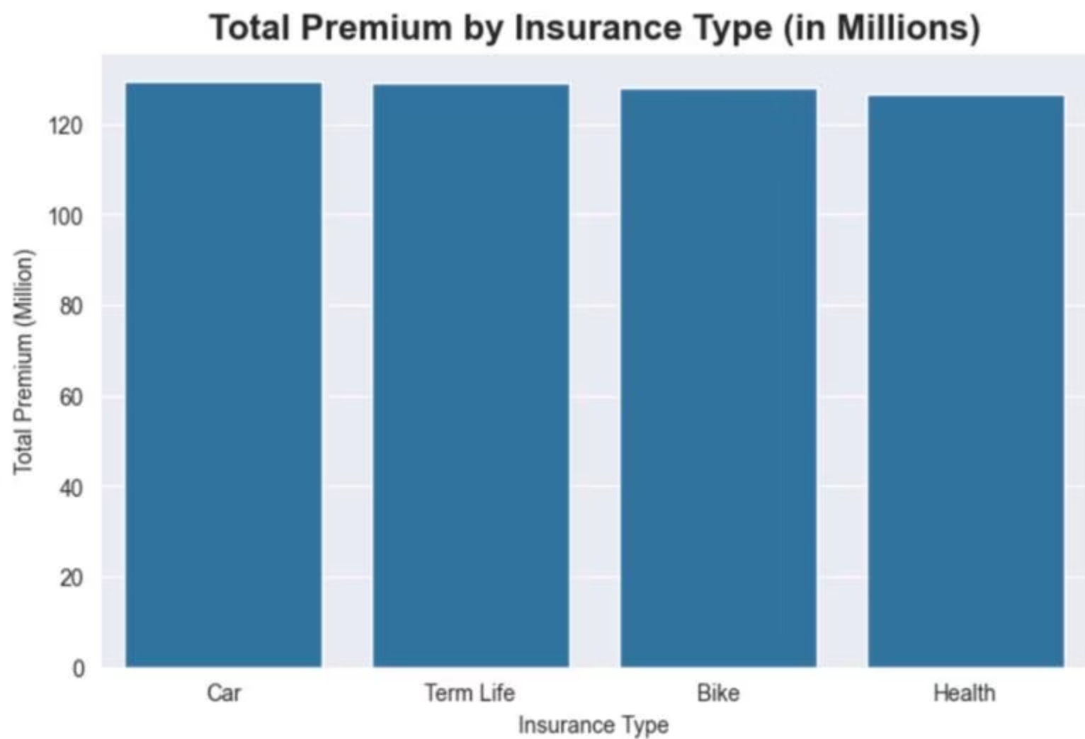

Key Findings: Transaction Performance
Insurance Premium Distribution
All four insurance types (Car, Term Life, Bike, Health) generated approximately 120 million in total premiums, showing balanced performance across categories.
Equal distribution suggests strong market penetration across all insurance segments

Slide 7
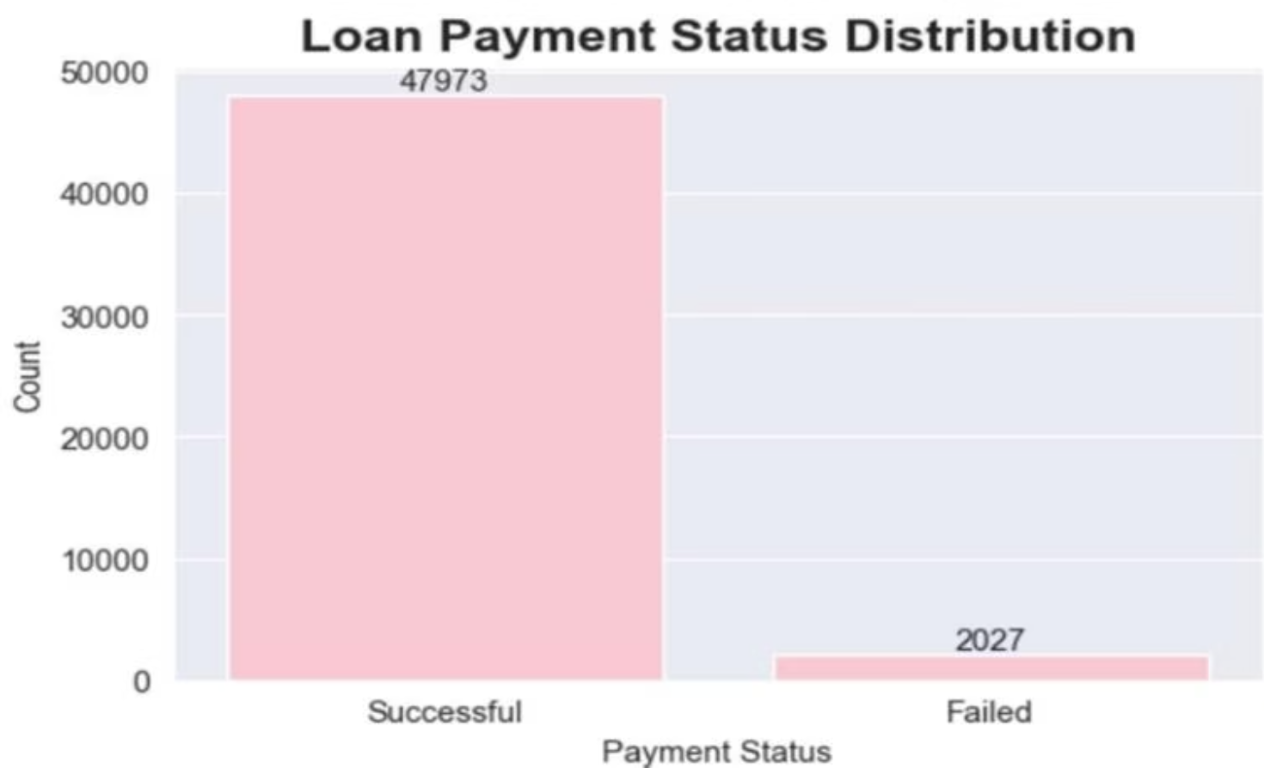
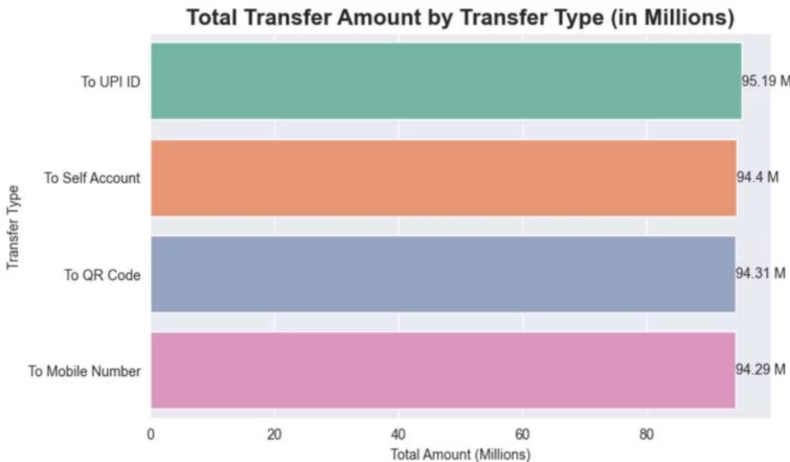
Transaction Success & Failure Analysis
Loan Payment Status
Money Transfer Distribution
Success rate: 95.9% (47,973 successful vs 2,027 failed)
Balanced usage across all transfer types: UPI ID (95.19M), Self Account (94.4M), QR Code (94.31M), Mobile (94.29M)

Slide 8
Power BI Dashboard Insights
3.3B
288K
12K
Total Amount
Successful Transactions
Failed Transactions
Transaction volume processed
4% failure rate requiring attention
96% success rate

Slide 9

KEY INSIGHTS
Critical Business Findings
High Volume, High Failure
Recharge & Bills drive highest transaction volume but show significant failure rates, indicating operational improvement opportunities
Failure Pattern Concentration
Server errors (33.76%), Wrong PIN (27.61%), and Insufficient funds (27.11%) account for majority of failures
High-Value Multi-Service Users
Subset of customers actively uses multiple Paytm services, representing prime targets for retention
Cross-Selling Potential
Strong opportunities exist between Recharge users and Financial services (Loans & Insurance)

Slide 10






Strategic Recommendations
Improve Gateway Reliability
Reduce recharge failures by addressing server errors and payment processing issues
Launch Loyalty Programs
Target high-frequency users with rewards to increase retention and lifetime value
Drive Cross-Selling
Promote Financial services to active Recharge & Bills customers
Optimize Recovery Flows
Improve UX for failed transaction recovery to reduce customer frustration
Focus Marketing Efforts
Concentrate campaigns on high-performing customer segments for maximum ROI

